Slide 1
BIOL0021
Advanced Human Genetics (1):
Research Principles
Linkage Mapping
2020-2021
David Curtis
d.curtis@ucl.ac.uk

Slide 2
Positional Cloning of Mendelian Diseases
The genetic analysis toolkit
Estimating the recombination fraction.
Testing for linkage.
Linkage maps.

Slide 3
Cytogenetic map
Linkage map
I I I I I I I I I I I I I I I I I I I I I I I
Nowadays: skip these steps, as complete human genome sequence available
Physical map (1)
YACs-PACs-BACs
Physical map (2)
Cosmids-Lambda
Gene Sequence
ATGCTGCTAGCTG/CATCGATCGATGCCTC
mutation

Slide 4
An autosomal
dominant
disease for which the
gene resides on
chromosome 1
But you don’t
know that!
Disease gene
1

Slide 5
Disease gene

Slide 6
Marker studied
Disease gene
5 6
4 7
2 3

Slide 7
Marker studied
Disease gene
2 3
1 5
4 4

Slide 8
Marker studied
Disease gene
1 5
3 5
6 7

Slide 9
Marker studied
Disease gene
2 4
2 5
2 7

Slide 10
Marker studied
Disease gene
1 3
1 2
4 5

Slide 11
Marker studied
Disease gene
2 4
2 5
2 7

Slide 12
Genotype data for the whole family
(23)
(16)
(14)
(26)
(34)
(13)
(58)
(12)
(13)
(78)
(26)
(47)
(24)
(46)
(33)
(14)
(18)
(25)
(18)
(27)
(46)
(67)
(24)

Slide 13
Positional mapping is based on Linkage
Mendel’s second law: independent assortment of alleles between loci
Four types of gametes are produced.
Under independent assortment, all are equally likely!
Deviation from these proportions ➔ LINKAGE
A a
B b

Slide 14
How does one evaluate recombination?

Slide 15
Haplotype
A combination of alleles (for different genes/markers) that are located closely together on the same chromosome and that tend to be inherited together.
The haplotype information on a parent is known as the phase of the parent’s meiosis.
genotype
AG CT
haplotypes
A T
G C
A C
G T
or

Slide 16
Recombination during meiosis
A
B
A
A
B
B
A
A
B
B
A
A
B
B
C
D
C
C
D
D
C
C
D
D
C
C
D
D
E
F
E
E
F
F
E
F
E
F
E
F
E
F
two parental
homologous
chromosomes
duplication
crossover between
non-sister chromatids
four gametes

Slide 17
Measuring recombination
Recombination fraction (RF or θ)
= # Recombinants/# observations.
For non-syntenic loci: RF = 0.5
For syntenic loci: the closer they are the less likely that a crossover occurs=> fewer recombinant haplotypes are generated (RF<0.5)

Slide 18
A family with Duchenne Muscular Dystrophy (D) and Fragile-X (F)
Estimating the Recombination Fraction
D,d
F,f
d
f
d
f
D
F
d
F
D
F
D
F
D
f
d
f
d
f
D
F
d
f

Slide 19
A family with DMD and Fragile-X
Estimating the Recombination Fraction
d D
F f
D d
F f
D,d
F,f
d
f
d
f
D
F
d
F
D
F
D
F
D
f
d
f
d
f
D
F
d
f

Slide 20
Maternal grand-parents provide phase of alleles in the mother
Unaffected dad
=> mother carries D and F
D,d
F,f
d
f
D d
F f
d
f
D
F
d
F
D
F
D
F
D
f
d
f
d
f
D
F
d
f
P
P
R
P
P
R
P
P
P
P
Recombination fraction, θ: 2/10 = 0.2

Slide 21
Estimating the Recombination Fraction
Ideally one wants 3 generation pedigrees in which:
  The genotypes of parents allow establishment of phase in children.
  The genotypes of grand-parents allow establishment of phase in parents and identification of recombinants in children.
  Parents are heterozygous at the two loci (double heterozygotes generate 4 gametic products).
Count # recombinants (R) and non-recombinants (NR):
  R.F. = R/(R+NR)

Slide 22
A simple “ideal” pedigree
1 1
1 1
1 2
1 2
1 1
1 1
1 2
1 2
1 1
1 2
1 2
1 1
1 2
1 2
1 1
1 1
RF = θ = 2/4 =1/2
Notes:
Only one parent informative

Slide 23
“Informativeness” of individuals

Slide 24
Gametes generated by individuals with different genotypes
1 1
1 1
1 1
1 2
1 2
1 2
1
1
1 1
1 2
1
1
2
2
2
1
1
2
P:
1
0.5 0.5
½(1- θ) ½(1- θ) ½ θ ½ θ
e.g: ¼ ¼ ¼ ¼
(unlinked loci)
n.b. Single or double homozygous individuals have obvious phase.
n.b. Only double heterozygote individuals can provide information on θ.

Slide 25
Mating type can be important e.g.:
1 2
1 2
1 1
1 1
1 2
1 2
1 1
1 1
1 2
1 2
1 2
1 2
1 1
1 1
2 2
2 2
1 2
1 1
1 1
1 2
1 2
1 2
Phase unknown.
Either 2 recombinants or
2 non-recombinants.
Notes:
Here both parents re informative

Slide 26
Mating type can be important e.g.:
1 2
1 2
1 2
1 2
1 1
1 1
2 2
2 2
1 2
1 1
1 1
1 2
1 2
1 2
1 2
1 2
1 2
2 1
Phase unknown.
Either 2 recombinants or
2 non-recombinants.

Slide 27
More polymorphic markers are more informative!
1 2
1 2
1 1
1 1
2 3
3 4
4 3
1 4
1 2
1 2
3 4
3 4
1 3
1 3
2 4
2 4
2 3
1 3
1 4
1 3
1 4
1 4
P P
P P
R
P
P R
P P
R.F. = 2/10
Notes:
Here both parents are informative

Slide 28
How does one test for linkage?

Slide 29
Testing for linkage
Test: H₀ : θ=0.5; H₁: θ <0.5
LOD score = Z score :
log₁₀ odds (linkage/no linkage)
LOD = log₁₀ {L(0 ≤θ <0.5)/L(θ = 0.5)}
L = likelihood function; allowing calculation of the probability of the data as a function of θ
linkage
no linkage : independent assortment

Slide 30
Probability v. Likelihood
Probability: hypothesis is fixed and used to obtain probability of a result; it is a number.
Likelihood: result is fixed and hypothesis is variable; likelihood is a function of the hypothesis.
Probability(d|θ)
= function(data d, parameter θ)
= Likelihood(θ|d)
Here: Calculate Z at θ = 0 - 0.5 and obtain Zmax

Slide 31
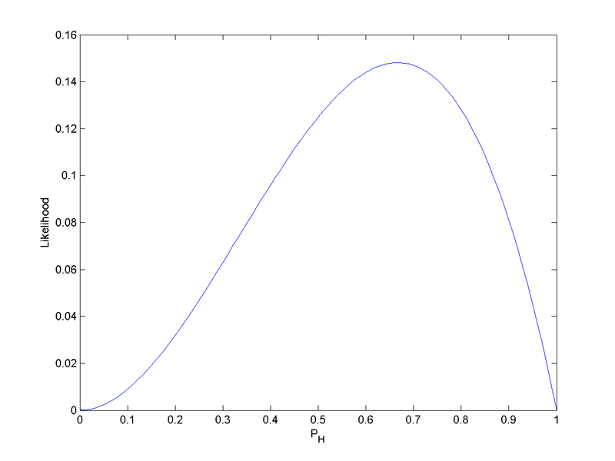
Likelihood function for estimating the probability of a coin landing heads-up after observing HHT
In linkage analysis we are interested in estimating Z as a function of θ
(and testing whether it is < 0.5).

Slide 32
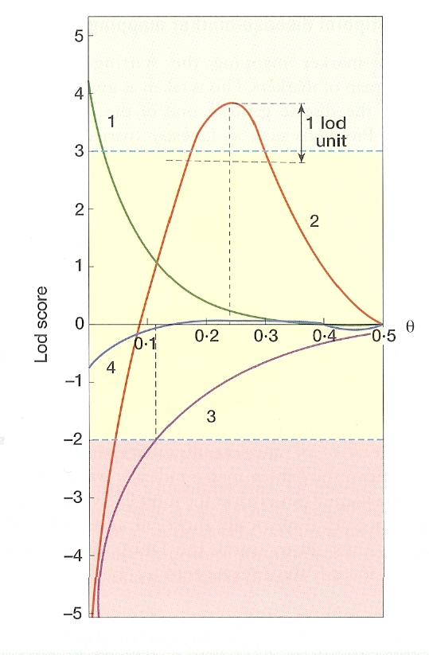
LOD score for 4 families at θ = 0 to θ = 0.5
Z_{max} occurs at best estimate of θ

Slide 33
Testing for linkage
Basic interpretation of the maximum LOD score (Z_{max}).
  > 3: accept linkage
  ≤ -2: reject linkage
  -2 ≤ Z < 3 : uncertain (collect more families)
N.B. LOD scores are additive across families: obtain total LOD score at a particular θ.
Notes:
When the lod score is greater than or equal to 3.0, there is “significant” evidence for linkage between the disease locus and the
marker locus. Although a lod score of 3.0 is consistent with odds of 1000:1 in favour of linkage between the loci, it is important to
note that a lod score of 3.0 is like any statistical assessment and can be a false-positive result. The higher the lod score, the
lower the chance of a false-positive result.
A lod score of -2.0 or less indicate odds of 10¯²:1 (0.01:1) or less in favour of linkage, or odds of 100:1 or more AGAINST linkage
of the two markers. This means the hypothesis of non-linkage between the disease and marker locus makes more sense, given
the available data, than the hypothesis of linkage.
A lod score between -2.0 and 3.0 is considered inconclusive and warrants additional study. A study is "expanded" by rendering
the currently available family data more informative (i.e., testing the family with different of more informative markers) or by
increasing the number of families under study. A lod score should always be considered in conjunction with its respective
estimate of Ø.

Slide 34
Interpretation of max LOD scores
In statistics, α-level = probability to achieve results if null hypothesis is true.
LOD score > 3 ⇒ Rejecting null hypothesis of θ =0.5 at α-level 0.0001.
Recall, LOD=3 ⇒ odds in favour of linkage = 1000:1.
Assume disease locus on only 1 autosome, so no linkage with 21 of 22 autosomes. Assume some other parameters. Then,
LOD score > 3 ⇒ Probability of the alternative hypothesis of θ <0.5 is 0.90.
Notes:
When the lod score is greater than or equal to 3.0, there is “significant” evidence for linkage between the disease locus and the
marker locus. Although a lod score of 3.0 is consistent with odds of 1000:1 in favour of linkage between the loci, it is important to
note that a lod score of 3.0 is like any statistical assessment and can be a false-positive result. The higher the lod score, the
lower the chance of a false-positive result.
A lod score of -2.0 or less indicate odds of 10¯²:1 (0.01:1) or less in favour of linkage, or odds of 100:1 or more AGAINST linkage
of the two markers. This means the hypothesis of non-linkage between the disease and marker locus makes more sense, given
the available data, than the hypothesis of linkage.
A lod score between -2.0 and 3.0 is considered inconclusive and warrants additional study. A study is "expanded" by rendering
the currently available family data more informative (i.e., testing the family with different of more informative markers) or by
increasing the number of families under study. A lod score should always be considered in conjunction with its respective
estimate of Ø.

Slide 35
Interpretation of max LOD scores
Sequential test of Morton (1955):
set α-level at 0.001 and other parameters, then
when LOD score > 3 ⇒ Reject null
In a genome-wide linkage scan with many markers, LOD score > 3.3 ⇒ genome-wide α-level 0.05.
Does not depend on the number of markers!
Notes:
When the lod score is greater than or equal to 3.0, there is “significant” evidence for linkage between the disease locus and the
marker locus. Although a lod score of 3.0 is consistent with odds of 1000:1 in favour of linkage between the loci, it is important to
note that a lod score of 3.0 is like any statistical assessment and can be a false-positive result. The higher the lod score, the
lower the chance of a false-positive result.
A lod score of -2.0 or less indicate odds of 10¯²:1 (0.01:1) or less in favour of linkage, or odds of 100:1 or more AGAINST linkage
of the two markers. This means the hypothesis of non-linkage between the disease and marker locus makes more sense, given
the available data, than the hypothesis of linkage.
A lod score between -2.0 and 3.0 is considered inconclusive and warrants additional study. A study is "expanded" by rendering
the currently available family data more informative (i.e., testing the family with different of more informative markers) or by
increasing the number of families under study. A lod score should always be considered in conjunction with its respective
estimate of Ø.

Slide 36
A simple likelihood function
1 1
1 1
1 2
1 2
1 1
1 1
1 2
1 2
1 1
1 1
1 1
1 2
1 2
1 2
1 1
1 1
1 2
1 2
1 2
1 1
1 2
1 2
1 1
1 1
P
R
P
P
P
R
P
P
R = 2
P = 6 = N-R
N = 8
Notes:
When recombination and non-recombination events within pedigrees can be counted with certainty, determining whether a disease allele in a pedigree is linked to a marker locus can be fairly straightforward. It can be difficult to classify a meiotic event as recombinant or non-recombinant, however; and even when it can be done, a statistical assessment of the strength of the evidence in favour of or against linkage is also required. First, a genetic model for the disease must be specified.

Slide 37
A simple likelihood function
Occurrence of recombinants
Occurrence of non-recombinants
Here: L(θ) = θ ^{R} (1- θ)^{N-R}
And: log L = R log θ + (N-R) log (1- θ)
At θ = ½ :
log L = N log (1/2)
Test:
Z = R log θ + (N-R) log (1- θ) – N log(1/2)
(Calculate Z at θ = 0- 0.5 and obtain Zmax)

Slide 38
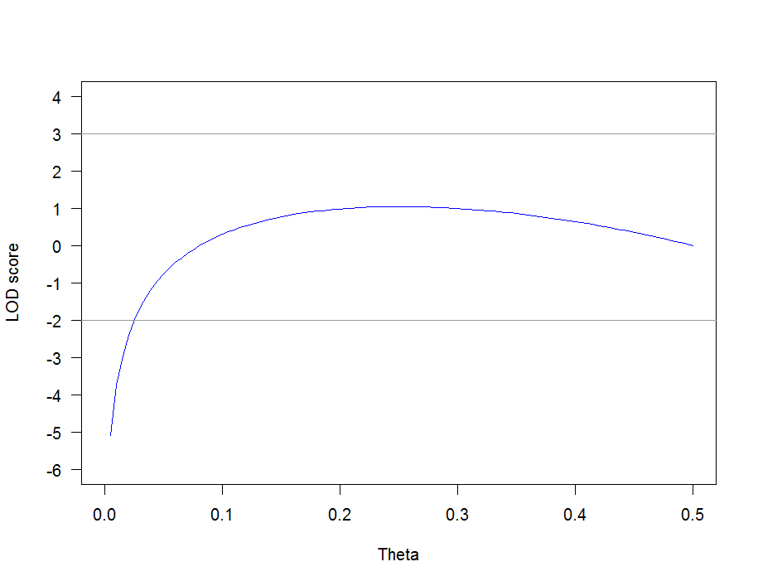
For this family the Z curve is:
Z = 2 log θ + 6 log (1- θ) – 8 log(1/2)
Notes:
Generated with R code:
curve(2*log(x)+6*log(1-x)-8*log(1/2),0,0.5, xlab = "Theta", ylab = "LOD score", ylim=c(-6,4), xlim=c(0,0.5), col = "blue",yaxt="n")
axis(2, las=1, at=-6:4)
abline(h=3, col = "gray60")
abline(h=-2, col = "gray60")

Slide 39
A special case
If R = 0:
at θ = 0, the LOD-score reduces to:
Z (θ) = - N log(1/2) = N log(2) = N 0.301
  N.B: With 10 observations one can reach significant linkage (if you type a marker v. close to the gene!).

Slide 40
Some missing information: no grandparents
1 2
1 2
1 1
1 1
1 2
2 1
1 2
1 2
Phase?
Two Possibilities:
Phase I
Phase II
1 1
1 1
1 2
1 2
1 2
1 2
1 1
1 2
P
R
P
R
P
R
R
P
In sum, two types of offspring (a:b): here a:b 3:1

Slide 41
A more complex likelihood function
Here: can’t be certain which are recombinant. Assume both phases are equally likely:
L(θ) = ½ θ ª (1-θ)^{b} + ½ θ ^{b} (1-θ)ª
Thus: less information than in phase-known case.
  - More data is needed to reach significance.

Slide 42
What if both parents are missing?
1 1
1 1
1 2
1 2
1 2
1 1
1 1
1 2
Still possible to obtain a LOD score but L needs to
consider all possible parental genotypes and phases:
➔ The likelihood function becomes more complicated.

Slide 43
Linkage between markers: genetic maps
First publicly available linkage maps were based on the CEPH (Centre d’Etude du Polymorphisme Humain) family collection:
  8 three generation pedigrees (4 grandparents, 2 parents and 9-15 children)
  188 meiosis for autosomes and 94 for the X chromosome
  Over 8,000 markers mapped.
More recently: DeCode genetic map, based on many more families: higher resolution. Latest maps are based on LD in population samples.

Slide 44
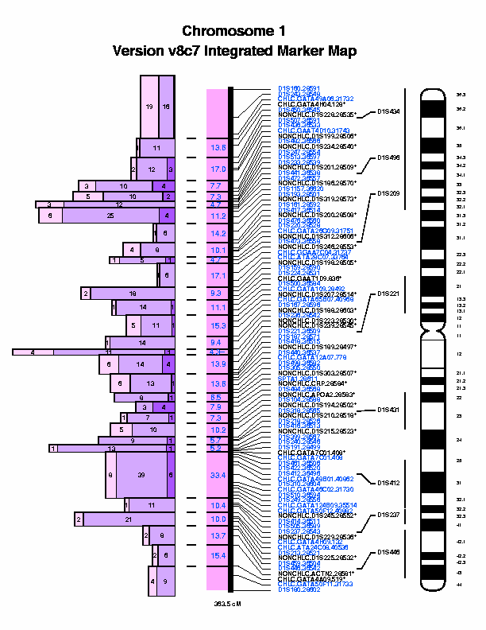

Slide 45
Genetic Distance
RF is the proportion of recombinants :
It is NOT additive
If recombination occurs at random it can be shown that:
    m = -1/2 ln(1-2θ) = expected number of crossovers
    (Haldane genetic distance; measured in Morgans M).
But at short distances: RF = Genetic distance (1 cM ≈ 1% RF)
Genetic distances are additive.

Slide 46
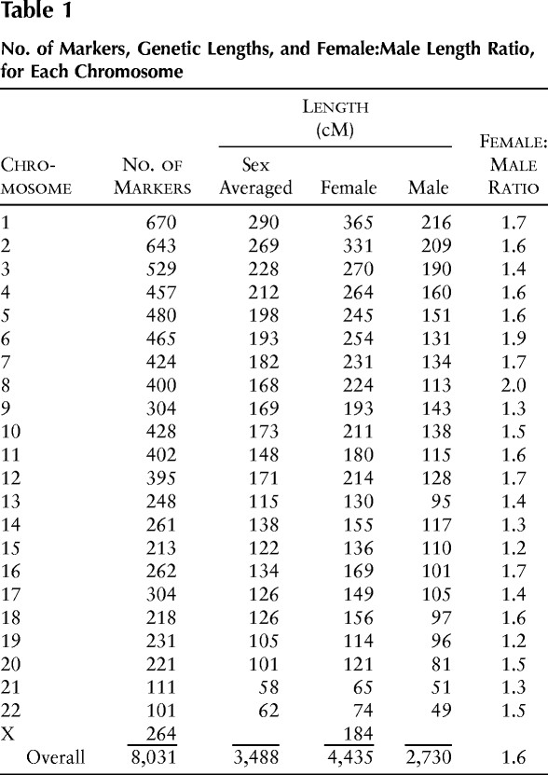
N.B. 1cM ≈ 1Mb

Slide 47
BIOL0021
Advanced Human Genetics (1):
Research Principles
Linkage Mapping – Part 2
2020-2021
David Curtis
d.curtis@ucl.ac.uk

Slide 48
How does all this apply to human disease?
Notes:
Blepharophimosis, Ptosis, Epicanthus Inversus Syndrome

Slide 49
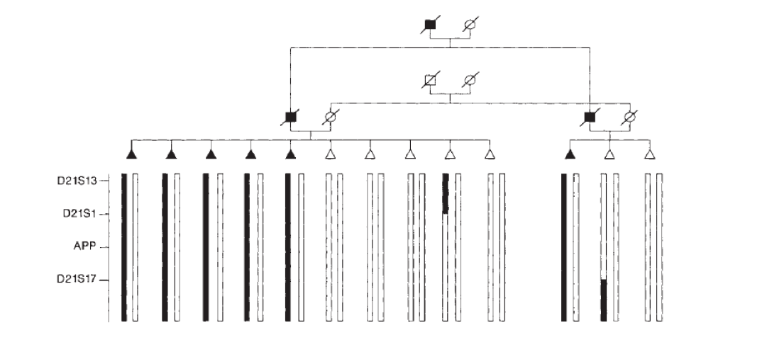
Intuition

Slide 50
Basic steps for linkage analysis of disease
Can be broken down into five steps:
  State the components of the genetic model.
  Assign underlying disease genotypes given information in the genetic model.
  Determine putative linkage phase of disease and marker alleles.
  Score meioses as recombinant or non-recombinant.
  Calculate and interpret LOD scores.

Slide 51
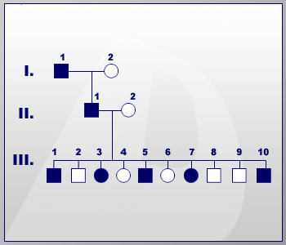
Specify the genetic model
A simple example:
Autosomal dominant inheritance
Complete penetrance
No genetic heterogeneity (no phenocopies)
Rare disease allele
The disease locus will be assumed to have two alleles: N (for normal or wild-type) A (for affected or disease)

Slide 52
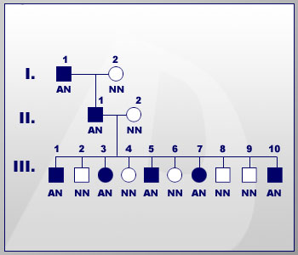
Assign underlying disease genotypes
The assumption of complete penetrance of the disease allele allows all unaffected individuals in the pedigree to be assigned a disease genotype of NN.
Since the disease allele is assumed rare, the disease genotype for affected individuals can be assigned as AN.

Slide 53
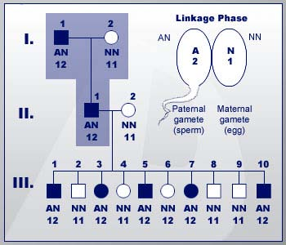
Determine putative phase
Individual II-1 has inherited the disease trait together with marker allele 2 from his affected father. Thus, the A allele at the disease locus and the 2 allele at the marker locus were inherited in the gamete transmitted to II-1.
Once the putative linkage phase (the disease allele "segregates" with marker allele 2) has been established, this phase can be tested in generation III.

Slide 54
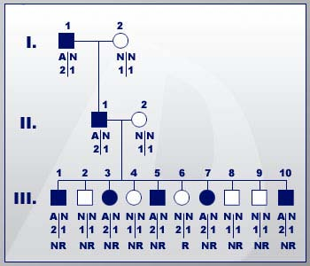
Score the meiotic events as recombinant (R) or non-recombinant (NR)
There are four possible gametes from the affected parent II-1: N1, N2, A1, and A2.
Based on the putative phase assigned in step 3, gametes A2 and N1 are non-recombinant.

Slide 55
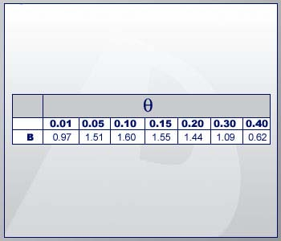
Calculate LOD scores
Z(θ)= R log θ + (N-R) log (1- θ) – N log(1/2)
Z(θ)= 1 log θ + 9 log (1- θ) – 10 log(1/2)
Notes:
R code for plot
curve(1*log10(x)+9*log10(1-x)-10*log10(1/2),0.0000001,0.5, xaxs="i", xlab = "Theta", ylab = "LOD score", ylim=c(-4,4), xlim=c(0,0.5), col = "red",yaxt="n")
axis(2, las=1, at=-6:4)
abline(h=3, col = "gray60")
abline(h=0, col = "black")
abline(h=-2, col = "gray60")
abline(v=c(0.01,0.05,0.1,0.15,0.2,0.3,0.4), lty=3, col = "blue")

Slide 56
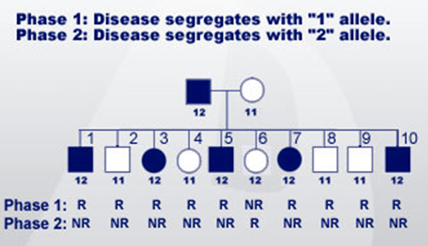
If we did not have the grandparents: phase unknown
One of two phases is possible.
In phase 1, the disease allele is segregating with marker allele 1.
Alternatively, the disease allele could be segregating with marker allele 2 (phase 2).
Under each phase, it can be determined whether or not the parental haplotypes in the offspring are recombinant or non-recombinant.

Slide 57
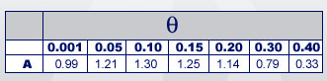
Calculate LOD scores
Here L is: L(θ) = ½ θ ^{R} (1-θ)^{N-R} + ½ θ ^{N-R} (1-θ)^{R}
L(θ) = ½ θ ¹ (1-θ)⁹ + ½ θ ⁹ (1-θ)¹
Notes:
R code for plot
curve(log10(0.5*((x^1*(1-x)^9/0.5^10)+(x^9*(1-x)^1/0.5^10))),0.0000001,0.5, xaxs="i", xlab = "Theta", ylab = "LOD score", ylim=c(-4,4), xlim=c(0,0.5), col = "red",yaxt="n")
axis(2, las=1, at=-6:4)
abline(h=3, col = "gray60")
abline(h=0, col = "black")
abline(h=-2, col = "gray60")
abline(v=c(0.01,0.05,0.1,0.15,0.2,0.3,0.4), lty=3, col = "blue")

Slide 58
Linkage analysis of human disease
More difficult because, often:
Uninformative individuals.
Different mating types.
Missing data.
Uncertainty of genotype at the disease locus (e.g. unaffected carriers)
➔ The likelihood function is usually (very) complex.
Notes:
Components of the Genetic Model
Components of the genetic model include inheritance pattern (dominant vs. recessive, sex-linked vs. autosomal), trait allele frequency (a common or rare disease?), and the frequency of new mutation at the trait locus. Another important component of the genetic model is the penetrance of the trait allele. Knowing the penetrance of the disease allele is crucial because it specifies the probability that an unaffected individual is unaffected because he's a non-gene carrier or because he's a non-penetrant gene carrier. The frequency of phenocopies is an important component, too.
Rough estimates of the disease allele frequency and penetrance can often be obtained from the literature or from computer databases, such as Online Mendelian Inheritance in Man (http://www.ncbi.nlm.nih.gov/omim/). Estimates of the rate of phenocopies and new mutation are frequently guesses, included as a nuisance parameter in some cases to allow for the fact that these can exist. Linkage analysis is relatively robust to modest misspecification of the disease allele frequency and penetrance, but misspecification of whether the disease is dominant or recessive can lead to incorrect conclusions of linkage or non-linkage.

Slide 59
In practice:
Positional mapping strategy
Assess power for detecting linkage in the study sample
Exclusion: examine linkage to candidate region
Fine map
Positional candidates
Mutation screening
Whole genome screen
Recently, if no power: use NGS

Slide 60
Some real examples:

Slide 61
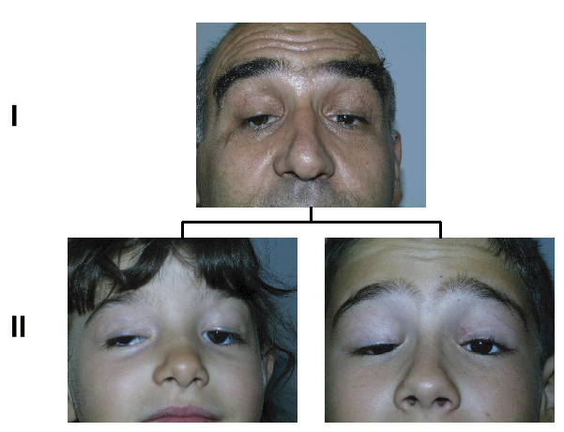
Three families with BPES
BPES-2
BPES-3
D3S1267
D3S1292
D3S3637
D3S1549
BPES-4
Data from American Journal of Medical Genetics 113:47–51 (2002)
Notes:
Different haplotypes can segregate in different families, different underlying mutations. But this does not affect linkage.
Blepharophimosis Ptosis Epicanthus Inversus Syndrome. The physical signs of BPES include abnormally narrow eyelids horizontally. The upper eyelids droop. A vertical fold of skin might form from the lower eyelid up either side of the nose.

Slide 62
LOD score analysis of BPES families

Slide 63
LOD score analysis of an autosomal recessive disease
Problem of phase in
parents and genotype
in unaffected offspring.
D d
1 2
d D
1 2
D D
1 2
? ?
1 2
? ?
1 1
D D
1 2
? ?
1 1
? ?
1 2
? ?
1 1
? ?
1 1
For calculation of Z: have to consider the two possible phases for each parent and the possible genotypes of unaffecteds at the disease locus.

Slide 64
Three families with juvenile Parkinson’s Disease
D6S305
D6S264
D6S305
D6S264
Data from Neurosci.Lett. 298, 87-90 (2001)
D6S305
D6S264

Slide 65
LOD score analysis of JPD families
!!!

Slide 66
Whole Genome Screen
~ 400 STR markers (about 1 marker every 10 cM)
Selected from Genethon/Decode map.
Commercial marker panels: e.g. AppliedBiosystems, Marshfield Foundation
More recently: linkage analysis with SNP chips (~10,000 SNPs).

Slide 67
Locus | Marker | Chr | Genetic position (cM) |  |  | Cytogenetic band |  | Repeat type | Physical Position (Mb)
 |  |  | Marshfield | Decode | Distance |  | Heterozygosity
D2S323 | AFM263WB5 | 2 | 5.4 | 4.61 | 0 | p25.3 | 59.88 | 2 | 2.65
D2S319 | AFM108XH8 | 2 | 7.6 | 7.81 | 3.2 | p25.2 | 74.27 | 2 | 5.04
D2S2211 | AFMA272YC5 | 2 | 15.61 | 18.24 | 10.42 | p25.1 | 76.32 | 2 | 7.48
D2S398 | AFMA127XB9 | 2 | 23.57 | 28.03 | 9.79 | p25.1 | 69.57 | 2 | 10.55
D2S168 | AFM240VF6 | 2 | 27.06 | 29.73 | 1.7 | p25.1 | 83.1 | 2 | 11.45
D2S305 | AFM073YA5 | 2 | 38.87 | 42.8 | 13.07 | p24.1 | 75.72 | 2 | 19.39
D2S146 | AFM198WC5 | 2 | 49.04 | 52.91 | 10.12 | p23.2 | 50.93 | 2 | 29.55
D2S2328 | AFMC014YC1 | 2 | 61 | 66.77 | 13.85 | p22.1 | 89.12 | 2 | 40.64
D2S2156 | AFMA119YE5 | 2 | 73.61 | 78.42 | 11.65 | p16.3 | 74.39 | 2 | 51.22
D2S1364 | GATA23H01 | 2 | 77.97 | 82.83 | 4.41 | p16.1 | 61.32 | 4 | 57.54
D2S337 | AFM275ZA9 | 2 | 80.69 | 86.05 | 3.22 | p15 | 87.96 | 2 | 61.63
D2S2152 | AFMA111YA9 | 2 | 87.62 | 94.62 | 8.57 | p13.3 | 53.63 | 2 | 69.67
D2S2110 | AFMA116ZH9 | 2 | 90.82 | 99.58 | 4.96 | p13.2 | 78.05 | 2 | 73.03
D2S2116 | AFMB313XD5 | 2 | 95.67 | 103.5 | 3.93 | p12 | 71.66 | 2 | 76.61
D2S388 | AFM333VH5 | 2 | 107.46 | 112.75 | 9.25 | p11.2 | 74.38 | 2 | 86.03
D2S293 | AFM205XA1 | 2 | 118.16 | 122.55 | 9.8 | q12.2 | 83.49 | 2 | 106.88
D2S363 | AFM303WC5 | 2 | 125.18 | 130.95 | 8.4 | q14.1 | 67.79 | 2 | 117.3
D2S347 | AFM289XB1 | 2 | 131.51 | 138.31 | 7.36 | q14.3 | 77.04 | 2 | 124.16
D2S2271 | AFMB285YH5 | 2 | 133.65 | 143.62 | 5.31 | q14.3 | 80.92 | 2 | 128
D2S2256 | AFM205xd4 | 2 | 141.62 | 149.54 | 5.92 | q21.2 | 69.18 | 2 | 133.88
D2S2324 | AFMC010ZA5 | 2 | 153.66 | 164.37 | 14.83 | q23.3 | 68.83 | 2 | 150.72
D2S1353 | ATA27H09 | 2 | 164.51 | 171.63 | 7.25 | q24.1 | 82.78 | 3 | 159.52
D2S2330 | AFMC015YD9 | 2 | 169.41 | 174.85 | 3.22 | q24.3 | 83.89 | 2 | 166.66
D2S2188 | AFMA203YE5 | 2 | 180.79 | 186.25 | 11.4 | q31.1 | 73.75 | 2 | 175.57
D2S118 | AFM066XC1 | 2 | 190 | 195.34 | 9.09 | q32.2 | 78.74 | 2 | 191.57
D2S2321 | AFMC009WH1 | 2 | 205.06 | 209.45 | 14.11 | q33.3 | 74.21 | 2 | 208.24
D2S317 | AFM094XF11 | 2 | 208.58 | 213.81 | 4.36 | q34 | 58.97 | 2 | 213.47
D2S2361 | AFMA052TC1 | 2 | 210.43 | 216.94 | 3.13 | q35 | 73.85 | 2 | 216.44
D2S2382 | AFMA082XC5 | 2 | 213.49 | 218.52 | 1.59 | q35 | 80.79 | 2 | 217.01
D2S163 | AFM234WA9 | 2 | 218.45 | 226.25 | 7.72 | q35 | 80.73 | 2 | 220.76
D2S133 | AFM165ZH8 | 2 | 224.33 | 232.12 | 5.88 | q36.1 | 62.59 | 2 | 224.6
D2S427 | GATA12H10 | 2 | 236.7 | 243.39 | 11.27 | q37.1 | 72.98 | 4 | 232.17
D2S2202 | AFMA239YC5 | 2 | 249.22 | 253.23 | 9.84 | q37.2 | 68.46 | 2 | 236.65
D2S338 | AFM276ZF5 | 2 | 250.54 | 253.84 | 0.61 | q37.2 | 81.75 | 2 | 237.25
D2S395 | AFM356TE5 | 2 | 261.34 | 262.12 | 8.28 | q37.3 | 80.57 | 2 | 241.26
D2S140 | AFM182YA5 | 2 | 263.56 | 265.28 | 3.16 | q37.3 | 75.3 | 2 | 241.76

Slide 68
Two-point maximum lod-scores for genome screen
Chromosome 2
Zmax
Position (cM)

Slide 69
Fine-mapping
Linkage analysis usually defines a candidate region of several cM (often tens of cM).
Since 1cM~1Mb: many possible candidate genes could be mutated.

Slide 70
Fine-mapping
To narrow-down the region:
  Haplotype analysis: extend pedigree, type more markers and search for recombinants: minimum shared haplotype between affecteds defines candidate region.
  Linkage disequilibrium (LD) analysis.

Slide 71
4 4
4 4
2 2
3 8
2 6
1 1
3 3
1 5
1 5
3 4
1 6
3 5
1 4
3 1
Identifying
flanking markers
Fully penetrant autosomal
dominant disease.
1 4
3 5
4 2
2 3
7 6
7 2
3 3
4 5
4 5
2 4
8 1
2 5
1 4
3 1
D14S35
D14s354
D14S78
D14S789
D14S23
D14S89
D14S33
4 4
5 4
2 2
3 8
6 2
2 1
3 3
4 5
5 5
2 4
3 1
6 5
2 4
3 1
4 4
5 4
2 4
3 1
6 5
2 4
3 1
4 4
5 4
2 2
3 8
6 2
2 1
3 3
1 4
3 4
4 2
2 8
7 5
7 4
3 1

Slide 72
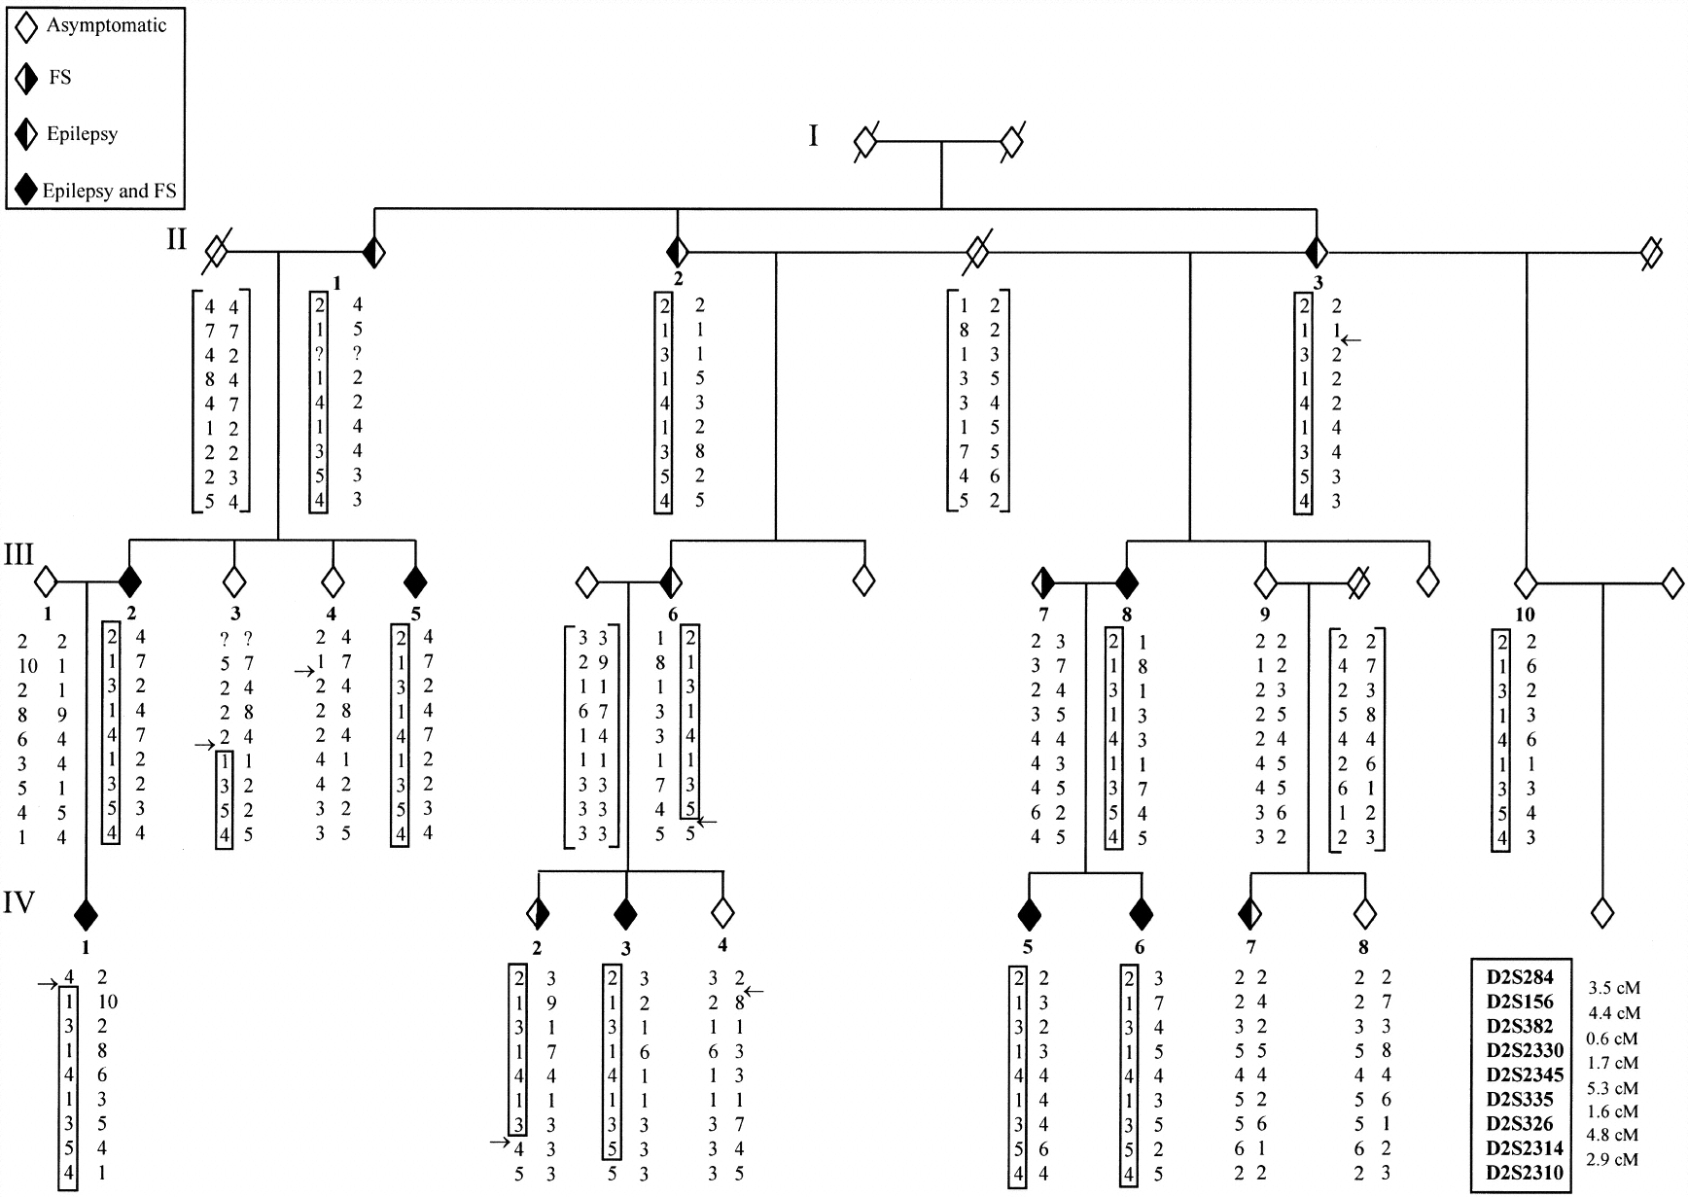
Extend pedigree

Slide 73
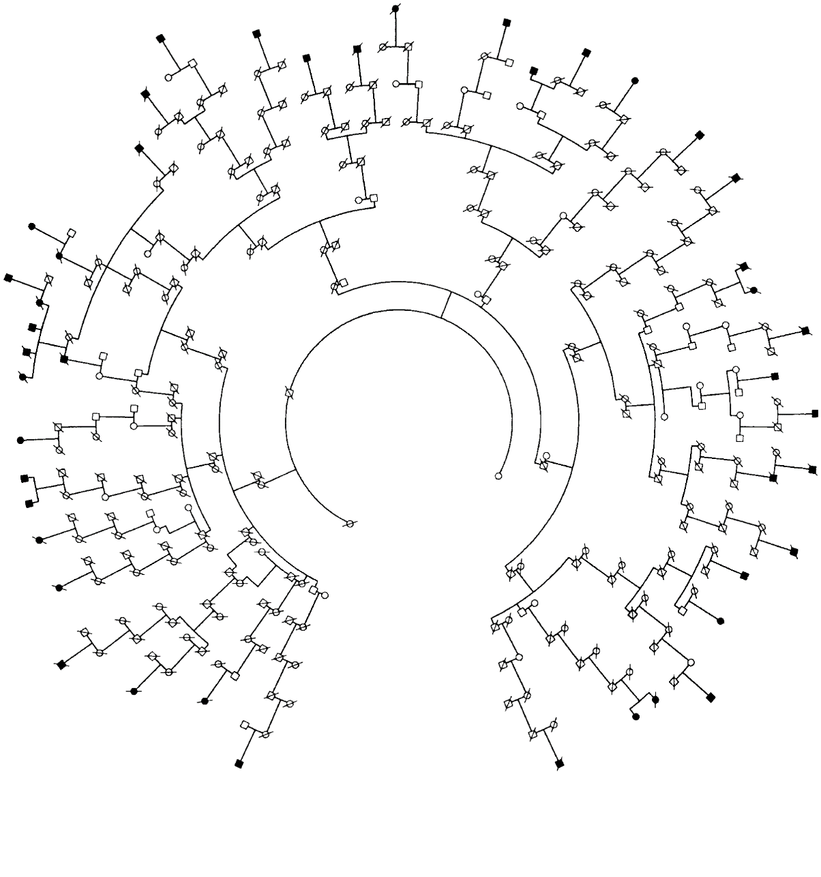
Extend even further

Slide 74
And further … a population!
Linkage disequilibrium!

Slide 75
Linkage Disequilibrium (LD)
Certain marker alleles are more common on mutant vs. non-mutant chromosomes.
  Tests of marker-disease association in population samples (e.g. mapping of Cystic Fibrosis CF).
Marker Alleles | CF chromosomes | Non CF chromosomes
A | 0.90 | 0.42
a | 0.10 | 0.58
B | 0.07 | 0.73
b | 0.93 | 0.27
Data from J Med Genet. 26, 426-430 (1989)

Slide 76
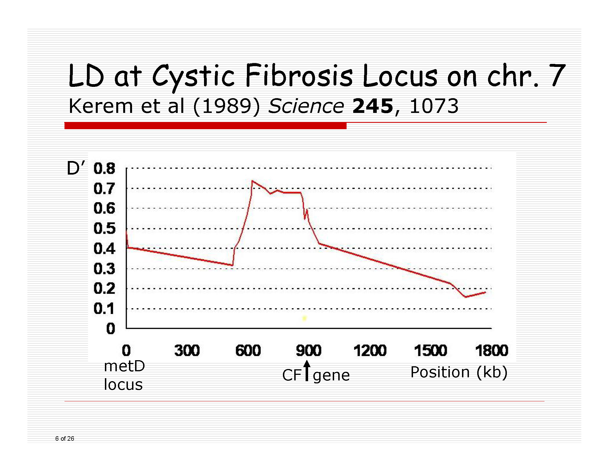

Slide 77
Linkage vs. Linkage Disequilibrium
Linkage is co-segregation of two loci,
Linkage Disequilibrium is co-segregation of two alleles.
LD is more strict.
It is okay for linkage if at the marker locus different alleles are inherited with the disease allele in different families.

Slide 78
References
Human Molecular Genetics 4. Strachan and Read. Chapter 14
Statistics in Human Genetics (1998). Pak Sham.
The Fundamentals of Modern Statistical Genetics (2011). Laird and Lange.
Browman et al. American Journal Human Genetics 63:861, 1998 (On linkage maps)
Kerem et al (1989) Science 245 p 1073. (a classic paper on the application of linkage)

